Slide 1
Technology Survey Dashboard Analysis
IBM Skills Network Capstone Final Report
Finnred Fernandes

Slide 2
Executive Summary
End-to-end dashboard analysis of developer survey data
Covers usage, trends, and demographics
Supports data-driven decision making

Slide 3
Methodology
Data cleaning and preprocessing
Handling missing values and duplicates
Multi-value feature transformation
Top 10 analysis and visualization

Slide 4
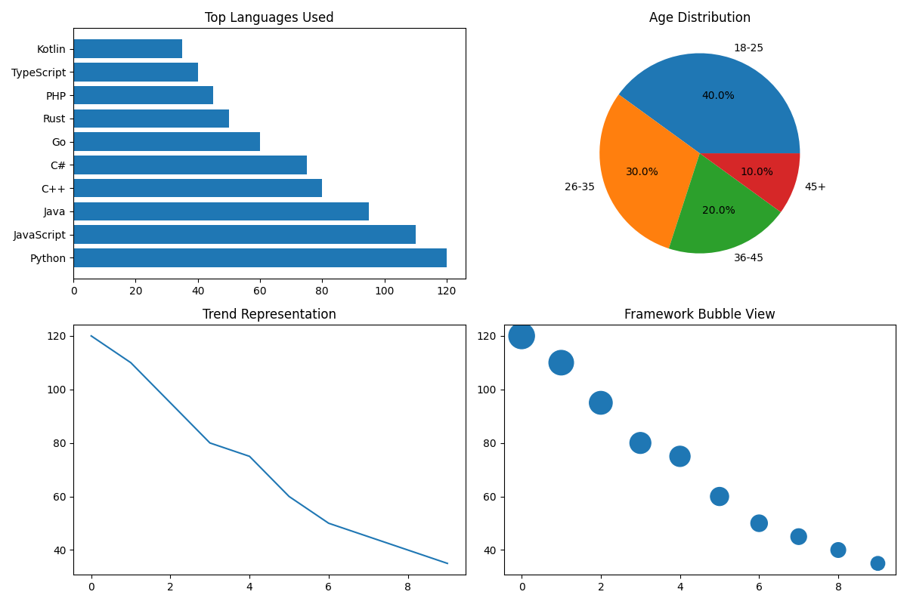
Current Technology Usage Dashboard
Python and JavaScript dominate usage. Databases and frameworks show consistent adoption patterns.

Slide 5
Future Technology Trends Dashboard
Future demand aligns closely with current usage, indicating stability in ecosystem growth.

Slide 6
Demographics Dashboard
Majority respondents fall in younger age groups. Education influences technology adoption.

Slide 7
Key Insights
Popular technologies remain dominant across usage and demand
Emerging tools show gradual adoption
Demographics strongly influence tech choices
Global trends show consistency across categories

Slide 8
Conclusion
Dashboard provides comprehensive analytical view
Findings support strategic planning
Future trends indicate continued evolution

Slide 9
Submission Checklist
Dashboard screenshots included
Correct visualizations used
Insights provided
Ready for PDF submission

